Slide 1
Understanding Key signatures

Slide 2
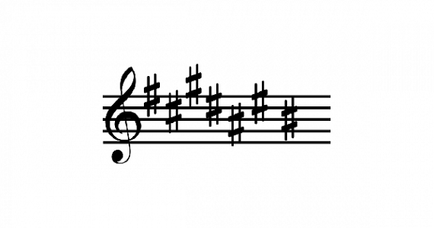
Sharps # : finding the key of a given key signature
Find the last sharp(#) of the key signature
Higher it (by one semitone).
In this case, the last sharp is B# (also known as C).
Higher it by a semitone, it makes the sharp, C#. So the key of this key signature is C# major.
Memorize that in sharps the only key signature with 1 sharp is G major.
There is an easy way to memorize the order of sharps, the initials of this phrase (below) ARE the order of sharps!
Order of Sharps: Father Charles Goes Down And Ends Battle
F# C# G# D# A# E# B#
Sharps Grouping: 2,3,2

Slide 3
Good thing to remember about sharps (Circle of Fifths)
Follow the Circle of Fifths!( C major 0 sharps, G major 1 sharp, D major 2 sharps and so on).
What will you do if you have the key and have to
Draw the key signature?

Slide 4
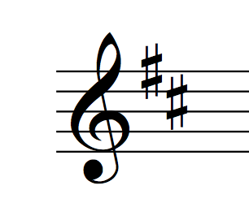
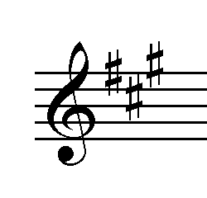
Examples
In this case, we see that the last sharp is C#, we higher it by
a semitone and it becomes D. So the key of this key signature is D major
In this case, the last sharp is G#, we raise it by a semitone and it becomes A. So the key of this key signature is A major.

Slide 5
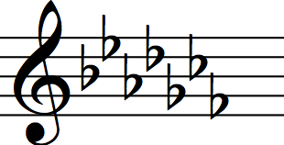
Flats
If you want to find out the key of a key signature consisting of flats, take the 2nd last flat of the key signature, that is the key! It’s that easy!
Anyway, the only thing you have to memorize in flats is that the only key signature with 1 flat is F major.
The same phrase we used for the order of sharps, can be used here to memorize the order of flats! The order of flats is the exact opposite of the order of sharps!
Order of Flats: Battle Ends And Down Goes Charles’ Father
All scales (with key signatures that have flats in them) will have a flat written in front of them (eg. Eb major) except F major

Slide 6
Good thing to remember (Circle of Fourths) about flats
If they have given the key and have asked you to draw the key signature, follow the Circle of Fourths( C major 0 flats, F major 1 flat, Bb major 2 flats and so on).

Slide 7
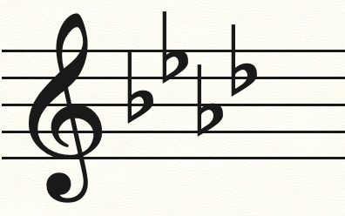
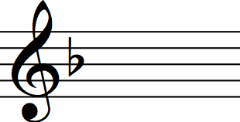
Examples
In this case we have 4 flats, if we go to the 2nd last flat, it is A flat. So the key of this key signature is A flat Major
In this case, we have only 1 flat. If you remember correctly, the only key signature with 1 flat is F major. And we do not put a flat in front of F. So the key of this key signature is F major

Slide 8
THANK YOU!
By ARYA RAO

